Slide 1
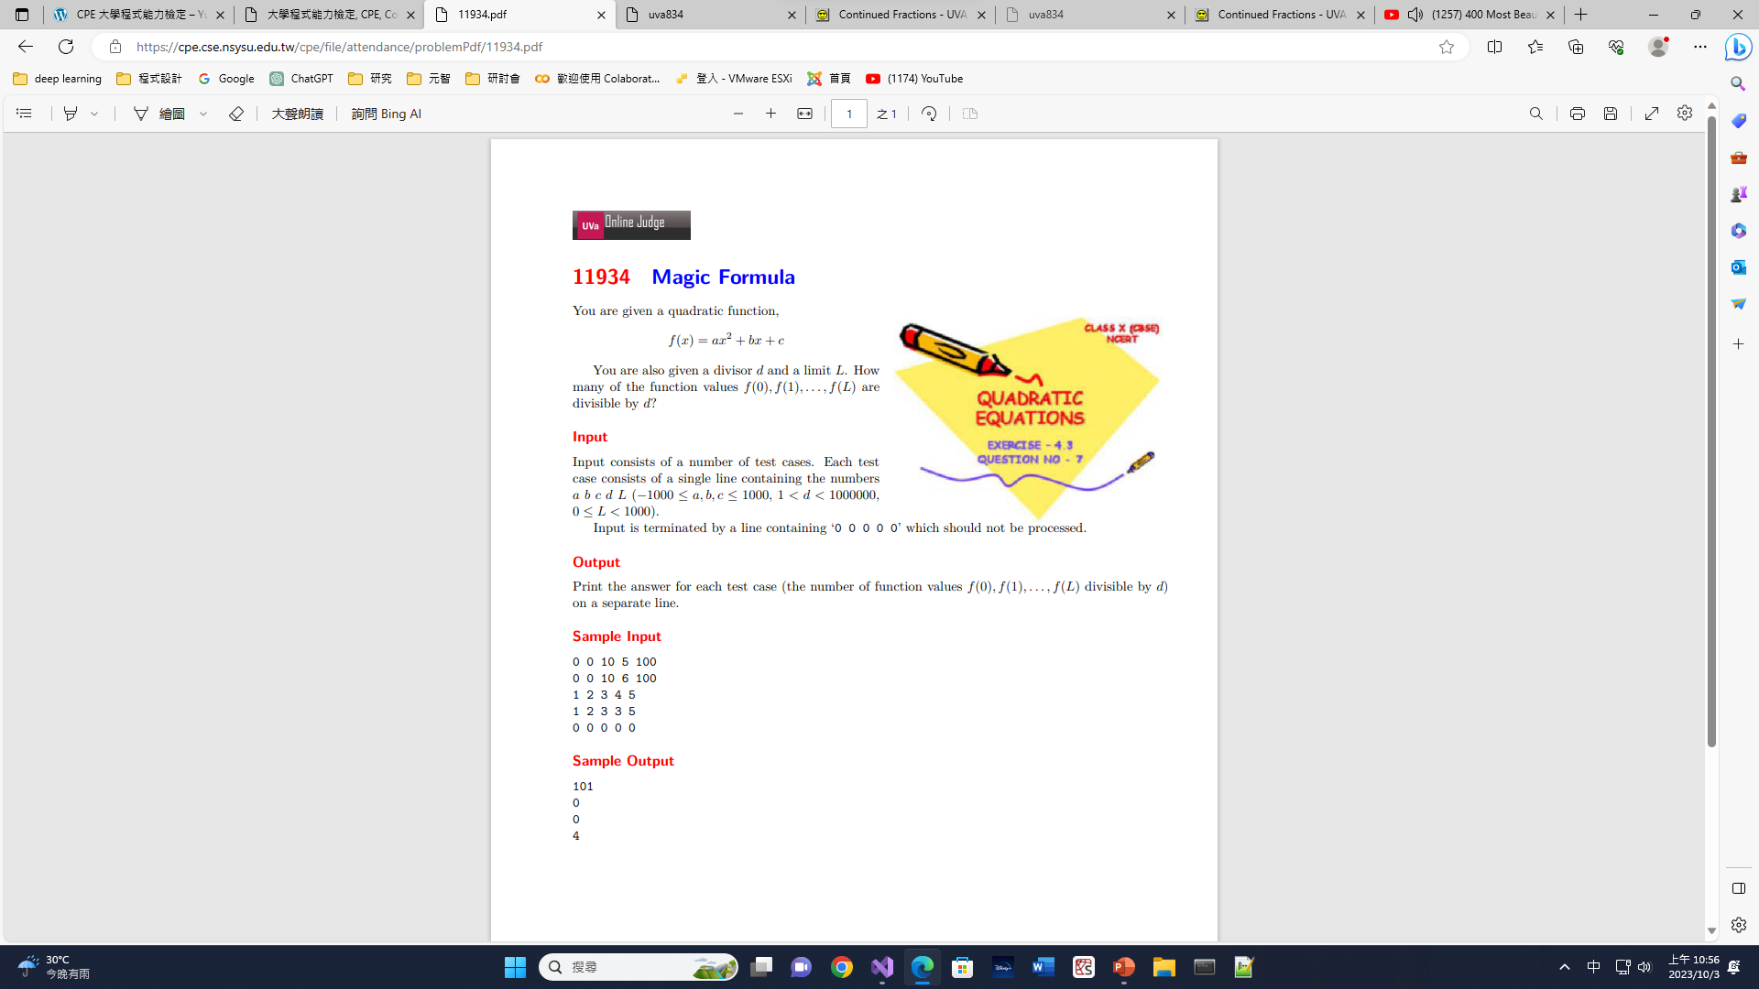

Slide 2
#include <iostream>
using namespace std;
int main() {
  int a, b, c, d, L, count;
  cin >> a >> b >> c >> d >> L;
  while (a != 0 || b != 0 || c != 0 || d != 0 || L != 0) {
    count = 0;
    for (int i = 0; i <= L; ++i) {
      if ((a * i * i + b * i + c) % d == 0)
      ++count;
  }
    cout << count << endl;
    cin >> a >> b >> c >> d >> L;
  }
  return 0;
}
0 0 10 5 100
0 0 10 6 100
1 2 3 4 5
1 2 3 3 5
0 0 0 0 0
101
0
0
4

Slide 3
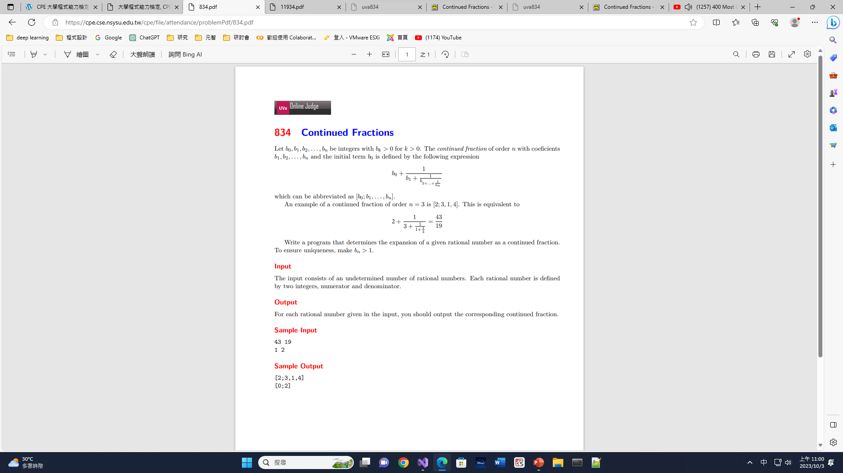

Slide 4

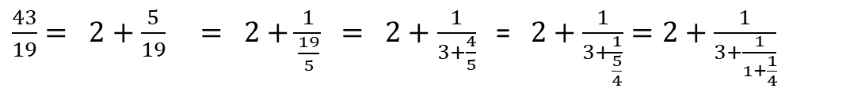

#include <iostream>
#include <vector>
using namespace std;
int main() {
  int n, m, q, r;
  vector<int> a;
  while (scanf("%d%d", &n, &m) != EOF) {
    while (m > 1) {
      q = n / m;
      r = n % m;
      a.push_back(q);
      n = m;
      m = r;
    }
    a.push_back(n);
    if (m == 0)
    a.pop_back();
    printf("[%d;", a[0]);
    n = a.size();
    for (int i = 1; i < n - 1; ++i)
    printf("%d,", a[i]);
    if (m !=0)
    printf("%d]\n", a[n - 1]);
    else
    printf(“]\n");
    a.clear();
  }
  return 0;
}
$\frac{43}{19}= 2+\frac{5}{19} = 2+\frac{1}{\frac{19}{5}} = 2+\frac{1}{3+\frac{4}{5}}$ = $2+\frac{1}{3+\frac{1}{\frac{5}{4}}}=2+\frac{1}{3+\frac{1}{1+\frac{1}{4}}}$
n=43
m=19
q=n/m=2
r=n%m=5
a=[2]
n=m=19
m=r=5
n=m=5
m=r=4
q=n/m=3
r=n%m=4
a=[2, 3]
q=n/m=1
r=n%m=1
a=[2, 3, 1]
n=m=4
m=r=1
a=[2,3,1,4]
$$\frac{1}{2}=0+\frac{1}{2}$$
$$\frac{15}{5}=3+\frac{0}{5}$$
n=1
m=2
q=n/m=0
r=n%m=1
a=[0]
n=m=2
m=1
a=[0,2]
n=15
m=5
q=n/m=3
r=n%m=0
a=[3]
n=5
m=0
a=[3,5]
a=[3]
43 19
1 2
15 5
[2 ; 3,1,4]
[0 ; 2]
[3 ; ]

